Slide 1
Spine
Vertbrae, Disc, Facet joints
Dr. Aranjan Karunanayake
MBBS, DM, DOH&S, Dip.Tox, Dipin. Coun, D.Sp.Med,MSc, FSS

Slide 2
Objectives for lecture on spine-
Should be able to identify different types of vertebrae and describe their features and identify the structures attached to them.
Describe the structure of the disc.
Describe the ligaments of the spine.
Briefly describe the muscles of the spine.
Describe the blood supply to the spine.
Describe the nerve supply to the spine.

Slide 3
Spine
Importance-
Protects the spinal cord.
Provide for muscle attachment.
Helps in weight bearing.
Helps in movement.
Causes clinical problems such as back pain, neck pain, neurological lesions etc.

Slide 4
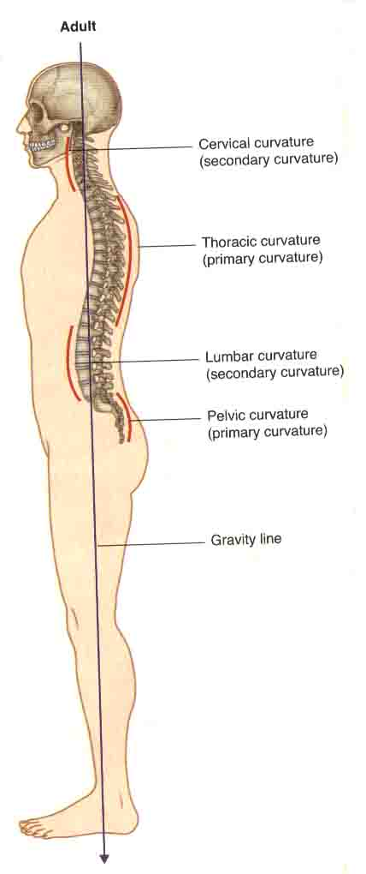

Slide 5
Anatomy of the spine-
Made up of vertebrae, discs, ligaments, muscles and fascia.
Each pair of adjacent vertebrae articulate by way of three separate joints. The two facet joints posteriorly and intervertebral disc anteriorly. There are firm fibrous ligaments to support these joints and limit the range of motion. Around these structures are the muscles and fascia. Muscles provide further support and aid mobility.

Slide 6
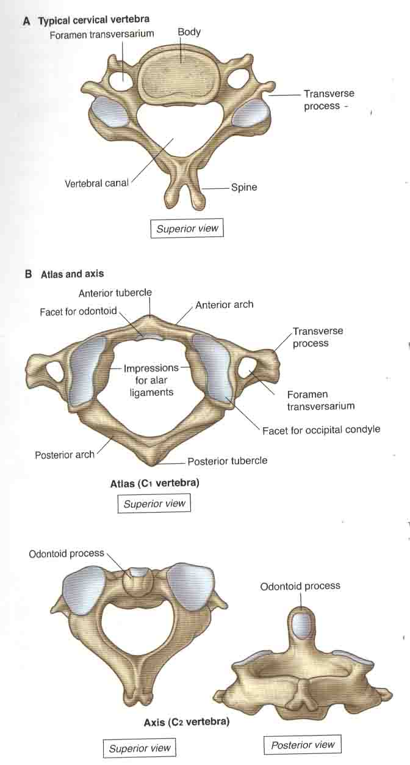

Slide 7
Vertebrae-
Cervical- seven in number. Spines are bifid (exc. C1 and C7).Foramen transversarium to transmit vertebral artery, vein and sympathetics. Articular facets relatively horizontal. Atlas(C1) has no body. Superior facets articulates with occipital condyles. Nodding and lateral flexion occurs at atlanto occipital joint.Axis (C2) has the odontoid process. Rotation of the skull occurs at atlanto axial joint around the dens. C7 is vertebra prominence.

Slide 8
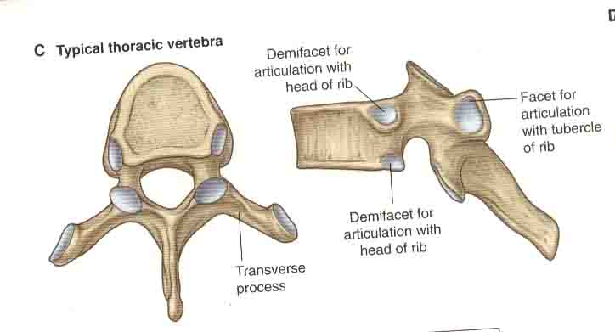

Slide 9
Thoracic-
Twelve in number.
Two demifacets on side of the bodies. Spines are long and directed downwards. Articular facets are relatively vertical. There are facets on the transverse process. Last two vertebra has only a single facet on the body. No facet on the transverse process. T5-T8 come into relationship with the descending aorta.

Slide 10
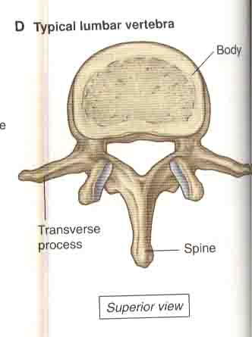

Slide 11
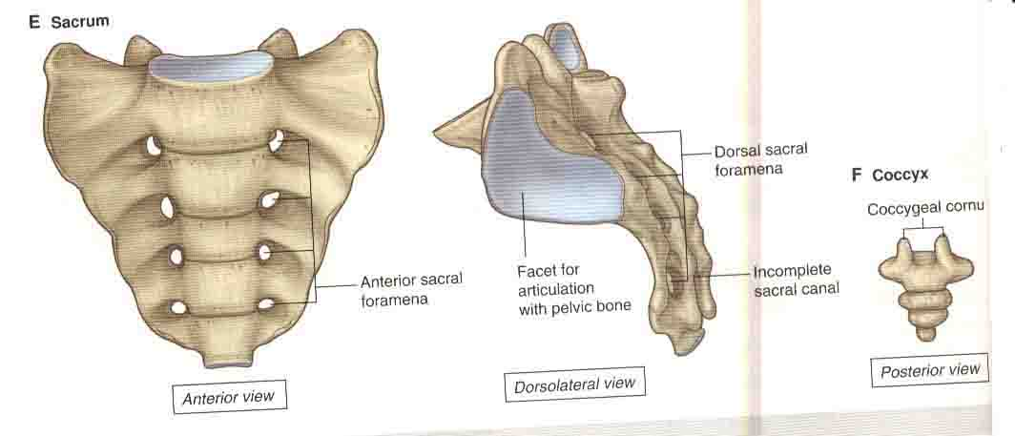

Slide 12
Lumbar-
Five in number.
Kidney shape bodies. Greater in size. Strong square horizontal spines. Articular facets in the sagital plane. L5 transverse process is massive. Attached to whole lateral aspect of pedicle. In other vertebrae transverse processes are attached to the junction of lamina and pedicle.
Sacrum- Five fused bones.
Coccyx – Three to five fused parts.

Slide 13
Sacrum-
Triangular shape. Made up of five fused vertebrae. Articulates with Ilium bone of the pelvis on either sides. Articulates above with the fifth lumbar vertebra.
Coccyx-
Attached to the lower end of the sacrum. Made up of four fused vertebrae.

Slide 14
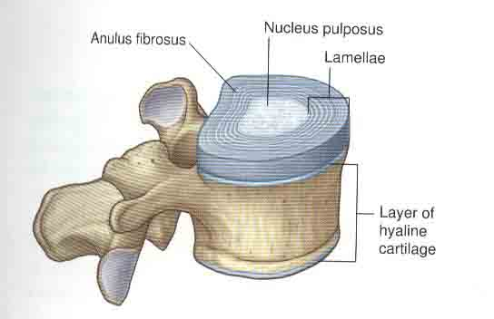

Slide 15
Intervertebral disc-
This connects cartilaginous end plates of two vertebral bodies. It is made up of fibro cartilage.It has an outer annulus fibrosus and a central neucleus pulposus.
Annulus fibrosus is formed by layers of collagen, ground substance (glycosaminoglycans) and connective tissue cells. Cartilage cells have a spherical and an elongated shape.
Nucleus pulposus has more ground substance. There are clusters and cords of large irregular notochordal cells. With increasing age these notochordal cells decrease in number and connective tissue cells appear.

Slide 16
Cartilaginous end plate-
Made up of hyaline cartilage. Plays an important role in the nutrition of the disc.

Slide 17
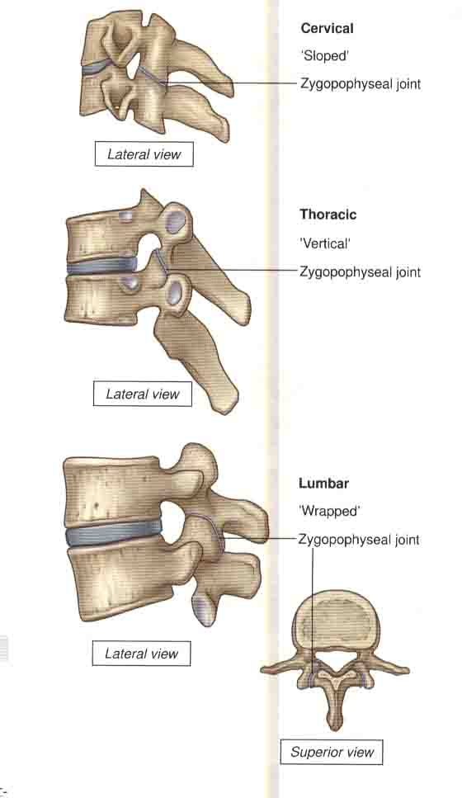
Zygoapophyseal joints-
Joints between superior and inferior articular processes of adjacent vertebra.
Synovial joints. Thin articular capsule is attached to the margins of articular facets.
Cervical - slope inferiorly from anterior to posterior. Facilitate flexion and extension.
Thoracic - More vertical. Facilitate rotation more. Limit flexion and extension.
Lumbar – Curved. Adjacent processes interlock. Limits movement. Flexion and Extension is a major action.

Slide 18
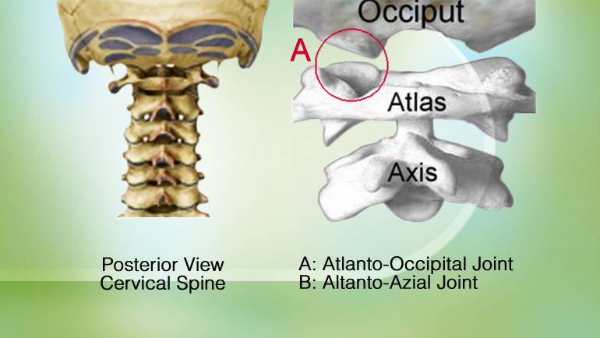
Atlanto Occipital and Atalanto Axial Joints

Slide 19
Summary
Typical cervical vertebrae have a foramen transversarium and a bifid spine.
Typical thoracic vertebrae have a heart shape body, two demifacets on the body, and a facet in the transverse process. Has a downward directing spine.
Typical lumbar vertebrae have a kidney shape body, large in size, horizontally directed spine.

Slide 20
Summary
Intervertebral disc has two parts. Thick Annulus fibrosus surrounds the nucleous pulposus. Annulus fibrosus has more collagen. Nucleous pulposus has more ground substance.
Cervical vertebrae has zygoapophyseal joints sloping in an antero posterior direction.
Thoracic vertebrae has zygoapophyseal joints in the vertical direction.
Lumbar vertebrae has interlocking type of facet joints.

Slide 21
Spine
Ligaments, Muscles, Fascia, development
Dr. Aranjan Karunanayake
MBBS, DM, DOH&S, Dip.Tox, Dipin. Coun, D.Sp.Med,MSc, FSS

Slide 22
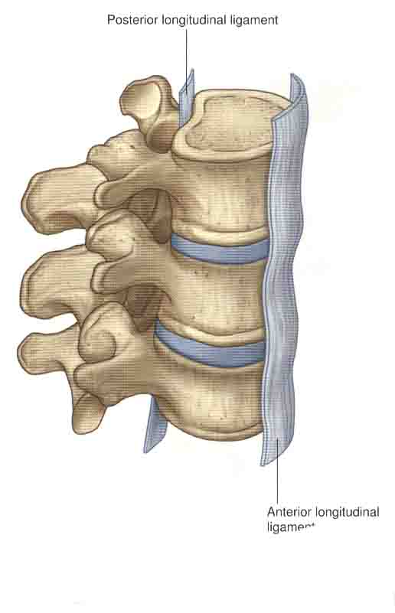
Anterior and posterior longitudinal – Extends along the anterior and posterior borders of the vertebral bodies.

Slide 23
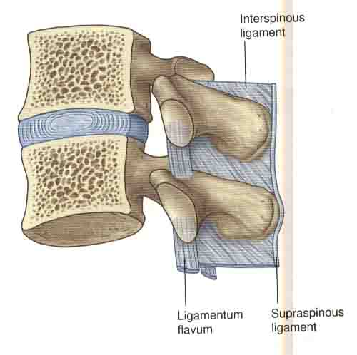
Interspinous ligaments- Connects spines togeather. Extends from the inferior surface of a spine to the superior surface of the spine below.
Supraspinous ligaments- Extends along the tips of the spines. C7-sacrum. Cervical – Lig.nuchae
Ligamentum flavum- Inferior surface of junctions of two lamina to the superior surface of junctions of two lamina of vertebra below. Elastic.

Slide 24
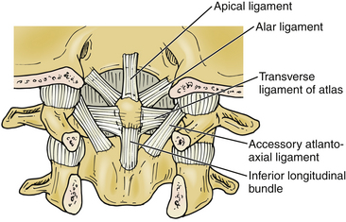
Ligaments Attached To Odontoid Process

Slide 25
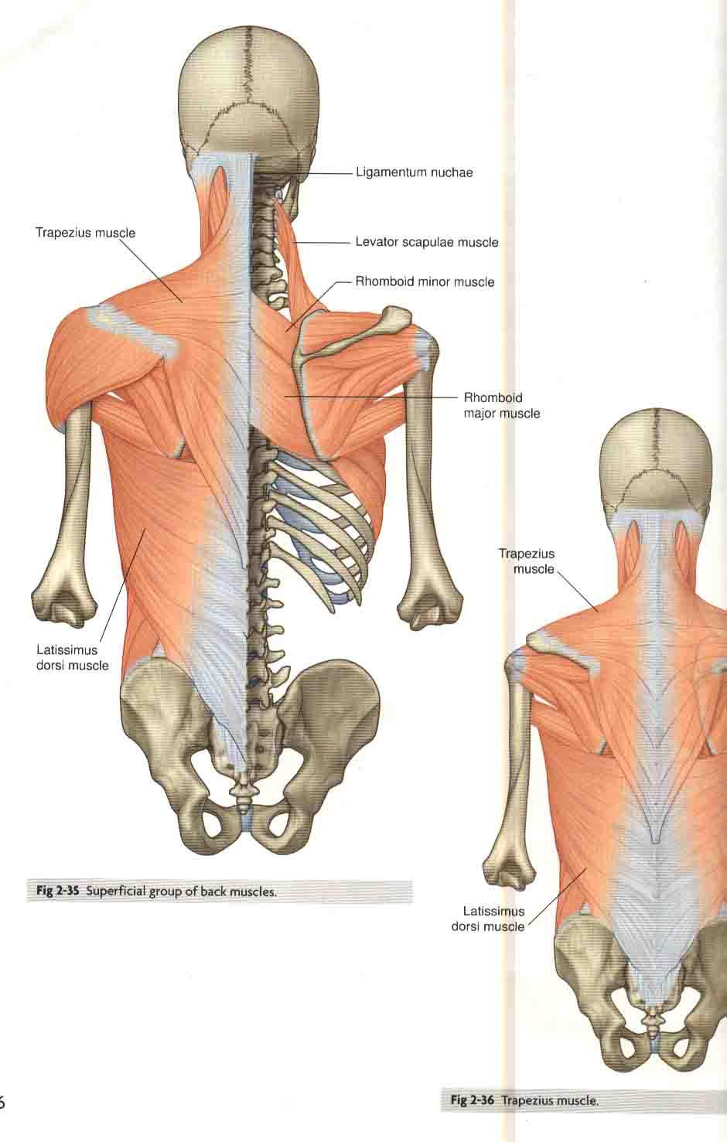
Superficial group-
Lies immediately deep to the skin and superficial fascia.
Supplied by ventral rami of spinal nerves.
They are attached to the clavicle, scapula, humerus(appendicular skeleton). Skull, ribs and vertebral column(axial skeleton).
They are involved in movements of clavicle, scapula and humerus.
Muscles included are- Trapezius, latissimus dorsi, rhomboid major and minor and levator scapulae muscles.

Slide 26
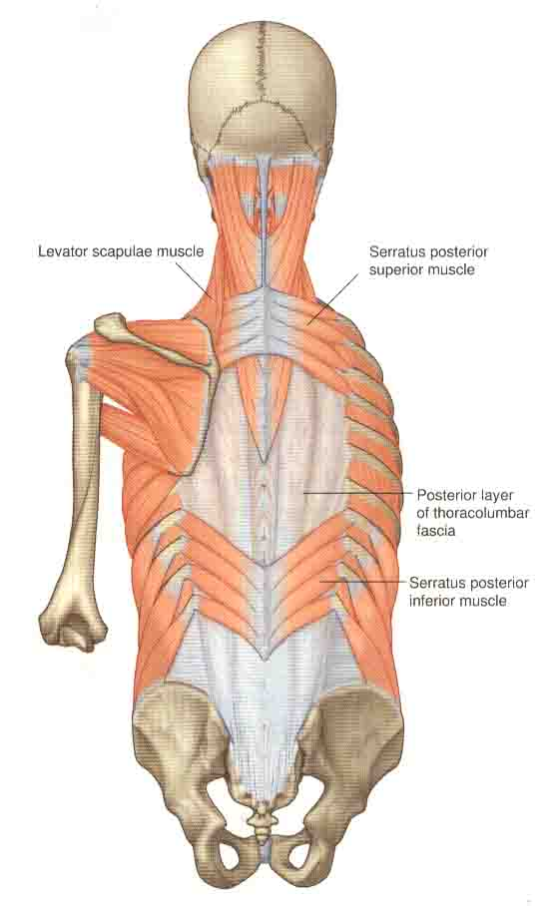
Intermediate group-
Lies deep to the muscles of the superficial group. Located in superior and inferior regions of the back.
Supplied by ventral rami of spinal nerves
Pass obliquely outwards from vertebral column to attach to the ribs. They help in respiration.
Two groups are serratus posterior superior and serratus posterior inferior. Actions of these muscles are to elevate and depress the ribs.

Slide 27
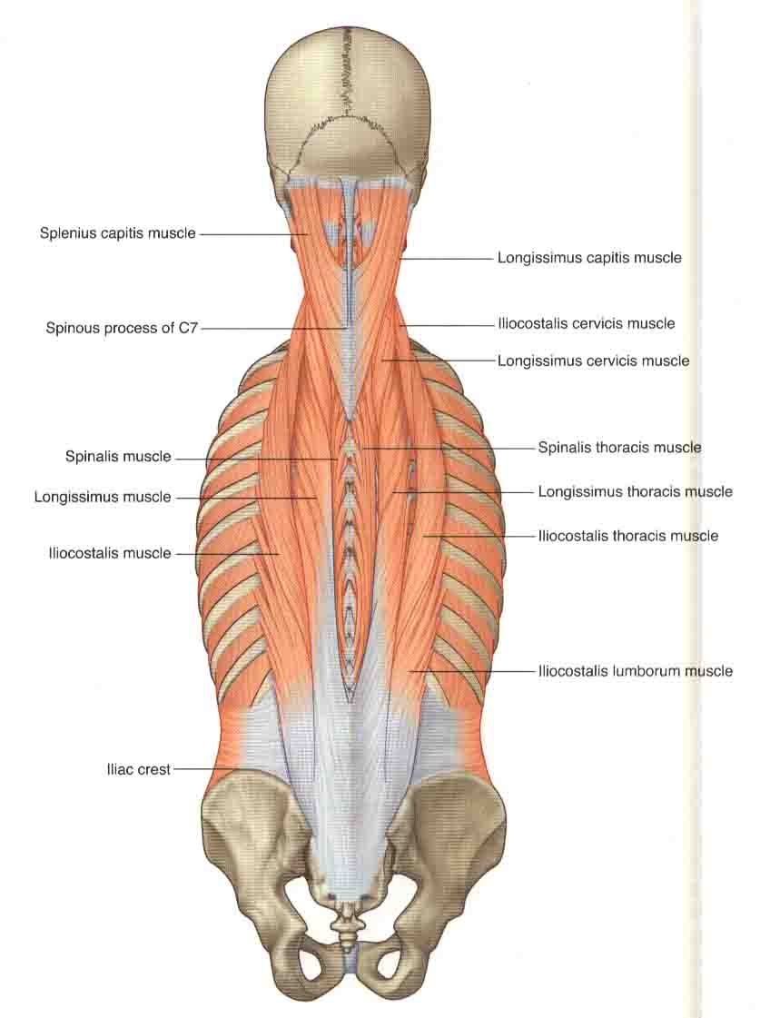
Deep group-
Extend from pelvis to the skull.
Supplied by dorsal rami of spinal nerves.
Erector spinae group, transversospinalis group and short segmental muscles. They are extensors, lateral flexors and rotators of vertebral column.

Slide 28
Erector spinae group –
Lies postero lateral to vertebral column.
Arranged in columns. Ilio costalis, longissimus and spinalis.
Longissimus is the largest group.
Each column is divided into lumborum, thoracis cervicis and capitis.
Long extensors of vertebral column and head.
Acting bilaterally they straighten the back.
Acting unilaterally can cause lateral bending of vertebral column and head.

Slide 29
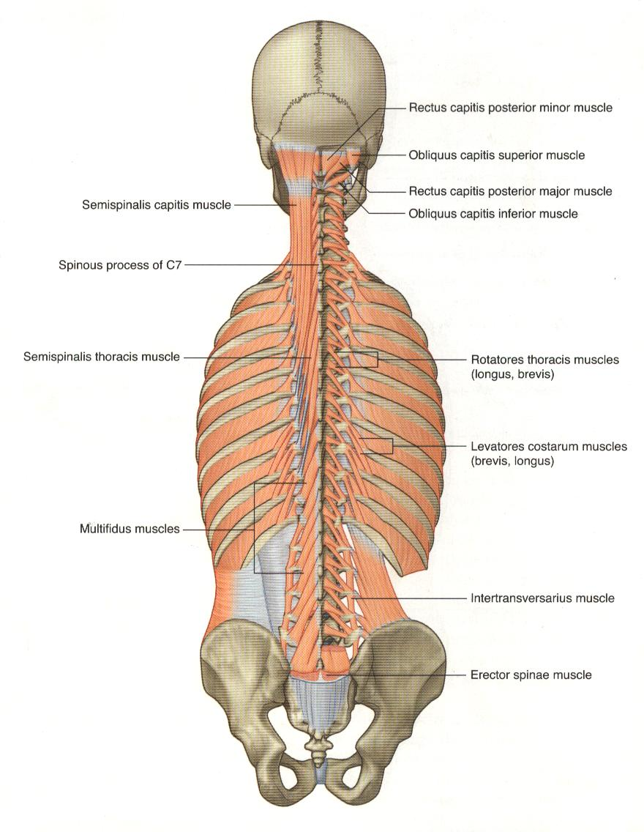
Transverso spinalis group-
Runs obliquely upward and medially from transverse process to spine.
Lie deep to the erecto spinae group. They are semispinalis, multifidus and rotatores.
Most superficial is semispinalis. Multifidus is present throughout the length. Best developed in lumbar region.
Rotatores is the deepest group.Present throughout the length. Best developed in thoracic region.
Rotatores can be long or short rotators.

Slide 30
When these muscles act bilaterally they extend the vertebral column. When contracts unilaterally causes lateral flexion. Also help in rotation.
Segmental muscles-
Levatores costarum muscles- Moving obliquely laterally downward.
Extend from transverse process to rib below. They elevate the ribs.
.

Slide 31
Second group consists of interspinalis muscles and inter transversarii muscles.
They help to stabilize adjoining vertebra during movements of the vertebral column.
Helps to assist more affective action of large muscle groups.

Slide 32
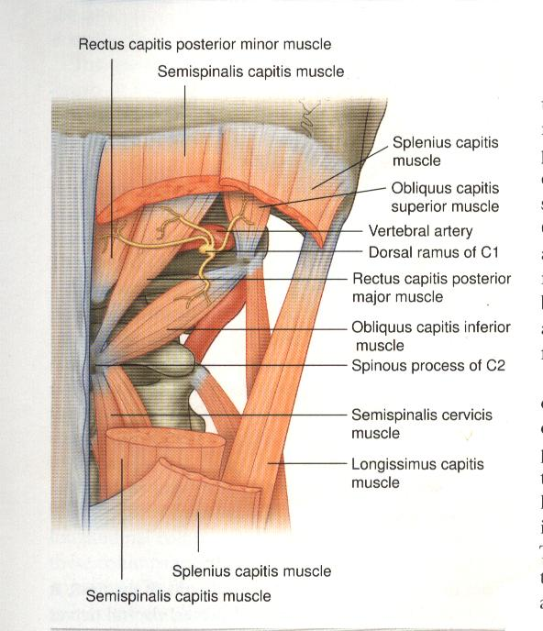
Sub occipital muscles-
These muscles connect C1to C2 vertebrae. Also both vertebrae to the base of the skull. They include
Rectus capitis posterior, major and minor.
Obliquies capitis superior and inferior.
Semispinalis capitis and splenius capitis.
When contracts bilaterally extend the head. When contracts unilaterally causes lateral flexion.
Innervated by dorsal rami

Slide 33
Other muscles attached to the spine –
Cervical region- rectus capitis anterior, rectus capitis lateralis and logissimus colli.
Posterior intercostal membranes of intercostal muscles.
Psoas major muscle.

Slide 34
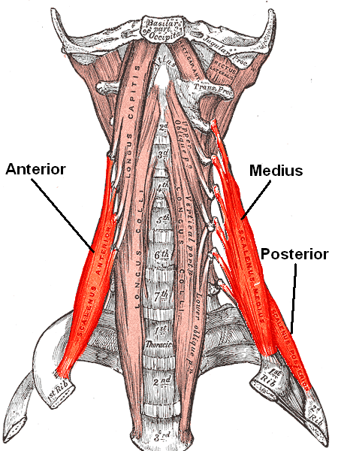
Anterior deep muscles of the neck
Longissimus coli
Longus capitis
Rectus capitis anterior
Rectus capitis lateralis

Slide 35
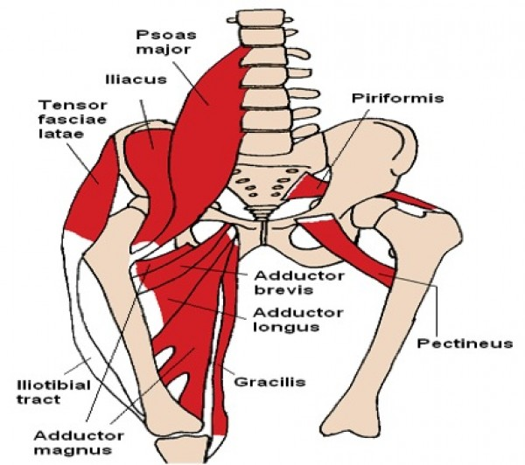
Anterior muscles attached in the lumbar region
Psoas major muscle

Slide 36
Arterial supply-
Sub occipital- vertebral and occipital arteries.
Superficial – transverse and ascending cervical.
Intermediate – intercostal arteries.
Deep – vertebral, deep cervical, occipital transverse cervical,posterior intercostal, subcostal,lumbar and lateral sacral.

Slide 37
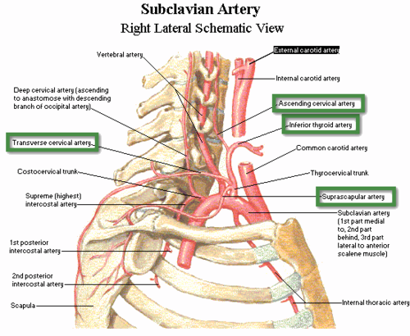
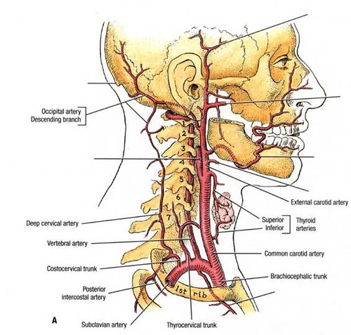
Arterial supply

Slide 38
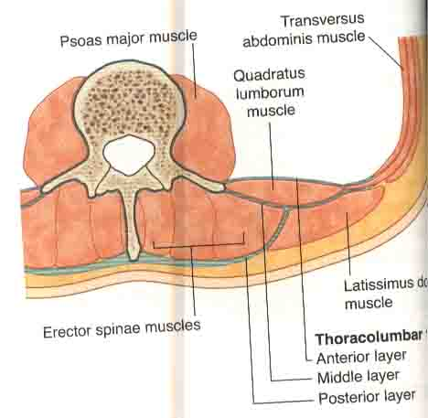
Thoracolumbar fascia-
Covers the deep muscles of the back and trunk.
Superiorly it is continuous with the investing layer of cervical fascia in the neck.
Post layer- Thick. Attached to the spines of lumbar and sacral vertebrae and supraspinuous ligaments. Extend laterally to cover the erector spinae.

Slide 39
Middle layer- Tips of transverse processes and intertransverse ligament. Extend Superiorly from T12 to iliac crest inferiorly. It form the lateral arcuate ligament. It meets post layer at lateral border of erector spinae.
Anterior layer- Tips of transverse process to lateral border of quadratus lumborum. It joins the middle layer. Helps to form the aponeurotic origin of transverse abdominis.

Slide 40
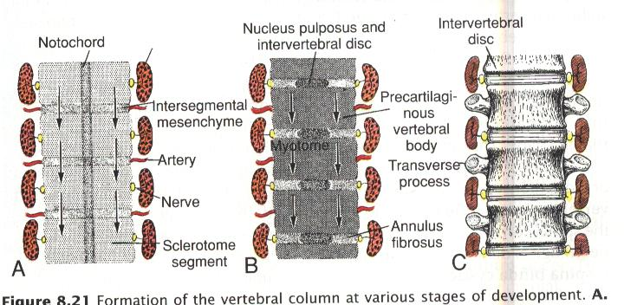
Vertebral column development-
4th week of development.
Cells of sclereotome surround the spinal cord and the notochord.
Caudal portion of each sclerotome proliferate extensively and condenses. This proliferation progress into subjacent intersegmental tissues.
Caudal ½ of one sclerotome unite with cephalic ½ of subjacent sclerotome forms the vertebral bodies.

Slide 41
Original sclerotomal cells between the caudal and cephalic parts do not proliferate. They form the intervertebral disc.
Notochord regresses in the region of vertebral bodies, but form the nucleus pulposus in the region of the disc.
Later the nucleus pulposus is surrounded by annulus fibrosus.
Dorsally the mesenchyme covers the neural tube and forms the vertebral arch
Ventrolaterally the mesenchyme forms costal processes (in the thorax form ribs)
Failure in the development of vertebral arches can give rise to Spina bifida condition

Slide 42
Summary
Musculature is organized into three groups. Superficial, intermediate and deep.
Superficial and intermediate are extrinsic muscles. Innervated by ventral rami of spinal nerves.
Superficial group is involved in movements of upper limb.
Intermediate group is attached to the ribs and serve a respiratory function.
Deep intrinsic muscles are innervated by dorsal rami of spinal nerves. Directly related to movements of the vertebral column and head.

Slide 43
Summary
Thoraco lumbar fascia has three layers. Posterior layer is attached to the tips of spines. Middle layer is attached to the tips of the transverse process and the anterior layer is attached to the anterior surface of the transverse process.

Slide 44
Summary
Caudal ½ of superior sclerotome unite with cephalic ½ of inferior sclerotome and form the vertebral bodies.
Original sclerotomal cells between the caudal and cephalic parts form the intervertebral disc.
Notochord forms the nucleus pulposus of the disc

Slide 45
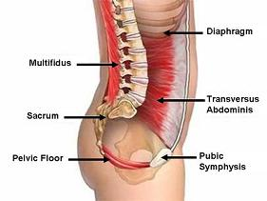
Deep Core Muscles of the Body

Slide 46
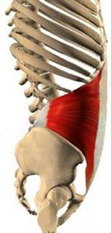
Transverse Abdominus

Slide 47
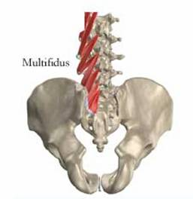
Multifidus

Slide 48
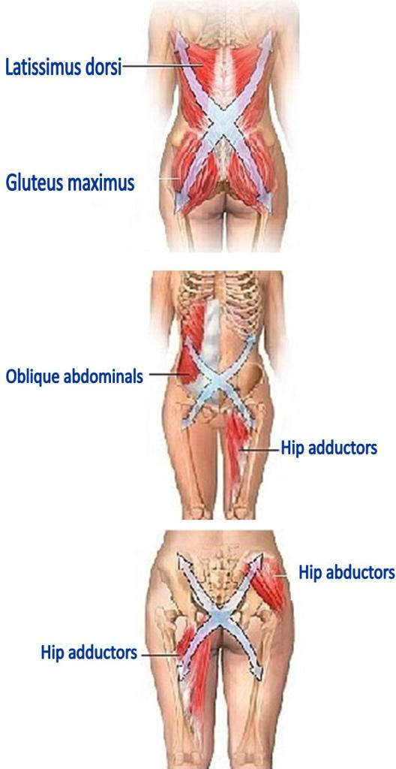
Superficial Core Muscles

Slide 49
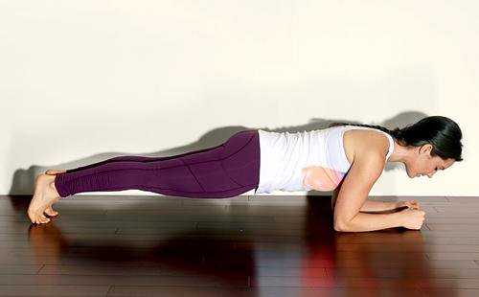
Co strengthening Exercises

Slide 50
Clinical Importance- Low back pain and neck pain are common problems of the spine. Low back pain is commoner than neck pain. Both have similar causes.
Low back pain can be divided according to the aetiology -
A) Potentially serious spinal conditions.
B) Sciatica- Back related lower extremity symptom that suggest nerve root compromise.
C) Mechanical.
Mechanical back pain is the commonest.

Slide 51
Common causes of mechanical back pain-
Disc degeneration.
Vertebral fractures.
Spondylolisthesis.
Injury to ligaments.
Injury to muscles.
Osteoarthritis of facet joints.

